Slide 1
Tangent Lines, Slope at a Point, Derivatives

Slide 2
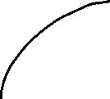
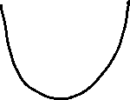
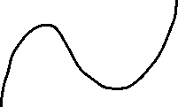
Tangent Lines: A tangent line to a curve is the straight line that most resembles the graph near that point. By finding the slope of a tangent line, we can find the slope of the curve at the given point.
Here are some examples of tangent lines:

Slide 3
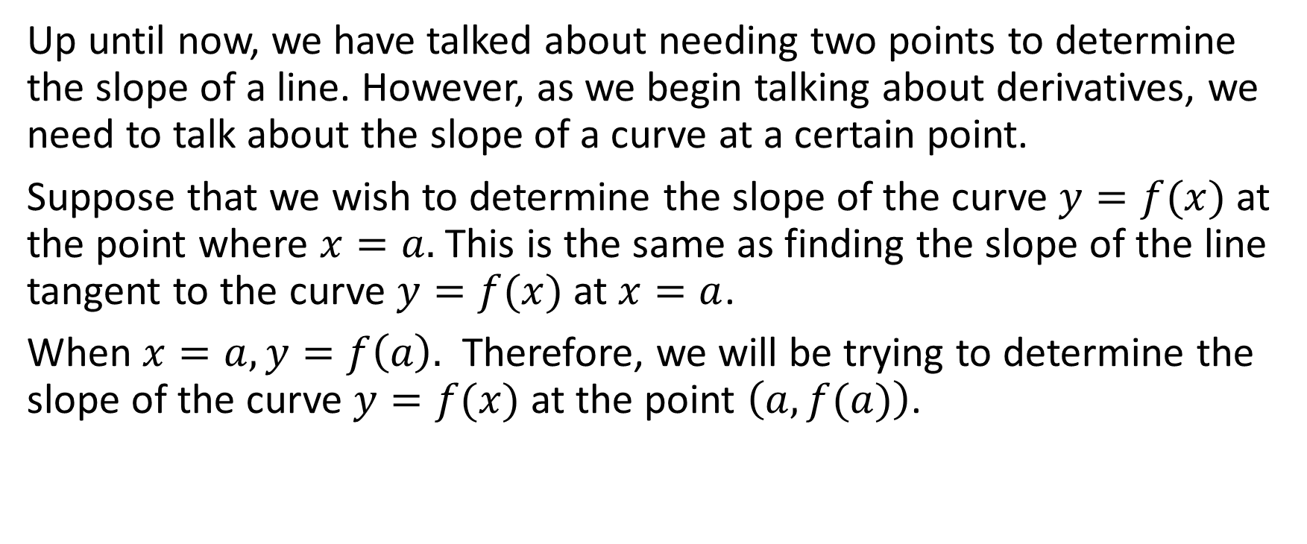
Up until now, we have talked about needing two points to determine the slope of a line. However, as we begin talking about derivatives, we need to talk about the slope of a curve at a certain point.
Suppose that we wish to determine the slope of the curve $y=f(x)$ at the point where $x=a.$ This is the same as finding the slope of the line tangent to the curve $y=f(x)$ at $x=a$.
When $x=a, y=f\left(a\right).$ Therefore, we will be trying to determine the slope of the curve $y=f(x)$ at the point $\left(a,f(a)\right)$.

Slide 4



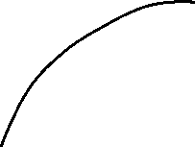
Establishing Derivative Formula
We are seeking to determine the slope of the line tangent to the curve $y=f(x)$.
$y=f(x)$
$$(a,f\left(a\right))$$

Slide 5
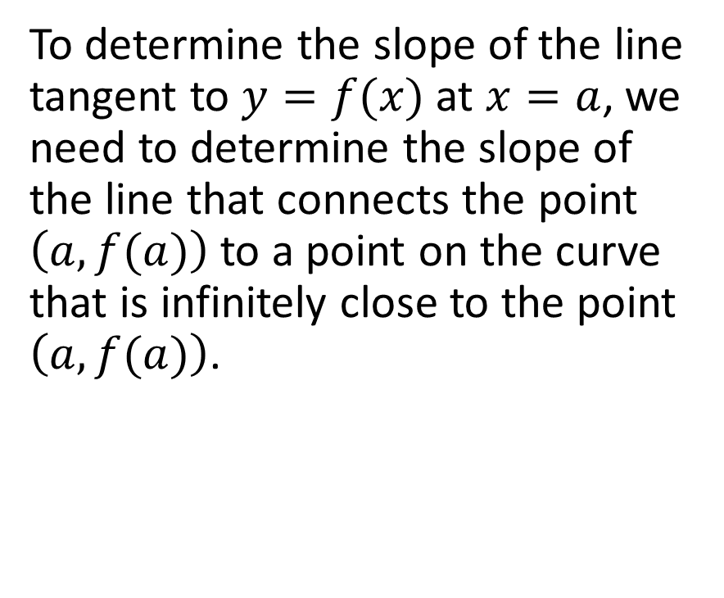
To determine the slope of the line tangent to $y=f(x)$ at $x=a$, we need to determine the slope of the line that connects the point $\left(a,f(a)\right)$ to a point on the curve that is infinitely close to the point $\left(a,f(a)\right)$.
$y=f(x)$
$$(a,f\left(a\right))$$

Slide 6

How do we find a point infinitely close to $(a,f\left(a\right))$ on the curve $y=f(x)$?
$y=f(x)$
$$(a,f\left(a\right))$$

Slide 7
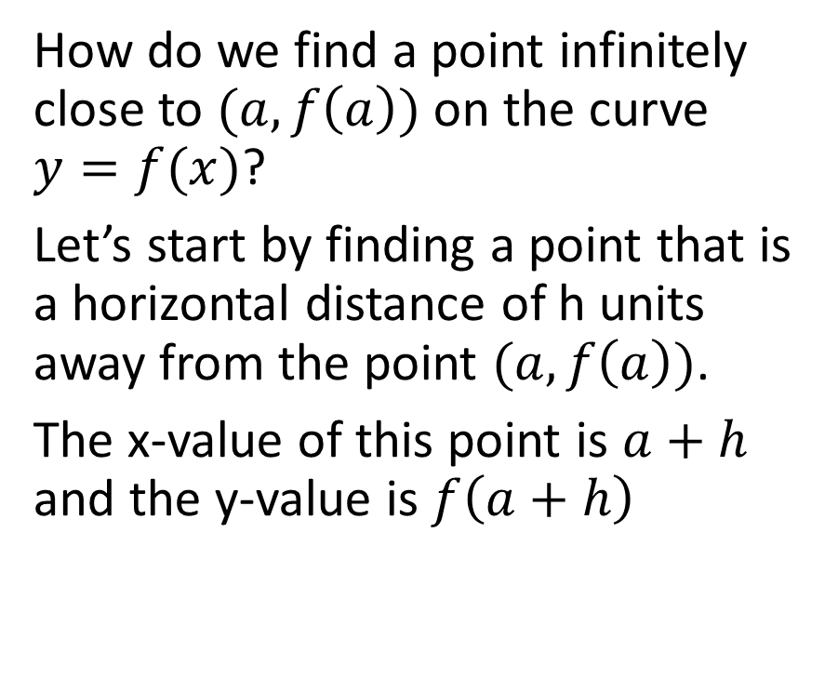
How do we find a point infinitely close to $(a,f\left(a\right))$ on the curve $y=f(x)$?
Let’s start by finding a point that is a horizontal distance of h units away from the point $(a,f\left(a\right))$.
The x-value of this point is $a+h$ and the y-value is $f\left(a+h\right)$
$y=f(x)$
$$(a,f\left(a\right))$$

Slide 8
How do we find a point infinitely close to $(a,f\left(a\right))$ on the curve $y=f(x)$?
Let’s start by finding a point that is a horizontal distance of h units away from the point $(a,f\left(a\right))$.
The x-value of this point is $a+h$ and the y-value is $f\left(a+h\right)$
$y=f(x)$
$$(a,f\left(a\right))$$
Horizontal distance is h

Slide 9
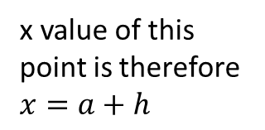
How do we find a point infinitely close to $(a,f\left(a\right))$ on the curve $y=f(x)$?
Let’s start by finding a point that is a horizontal distance of h units away from the point $(a,f\left(a\right))$.
The x-value of this point is $a+h$ and the y-value is $f\left(a+h\right)$
$y=f(x)$
$$(a,f\left(a\right))$$
x value of this point is therefore $x=a+h$
Horizontal distance is h

Slide 10

How do we find a point infinitely close to $(a,f\left(a\right))$ on the curve $y=f(x)$?
Let’s start by finding a point that is a horizontal distance of h units away from the point $(a,f\left(a\right))$.
The x-value of this point is $a+h$ and the y-value is $f\left(a+h\right)$
$y=f(x)$
$$(a,f\left(a\right))$$
The y-coordinate is $f(a+h)$
Horizontal distance is h

Slide 11

How do we find a point infinitely close to $(a,f\left(a\right))$ on the curve $y=f(x)$?
Let’s start by finding a point that is a horizontal distance of h units away from the point $(a,f\left(a\right))$.
The x-value of this point is $a+h$ and the y-value is $f\left(a+h\right)$
($a+h,f(a+h)$)
$y=f(x)$
$$(a,f\left(a\right))$$
Horizontal distance is h

Slide 12

Now, we determine the slope of the line that connects these two points.
We see that the slope of that line will be a very rough approximation of the slope of the tangent line.
We will call this an approximation line.
($a+h,f(a+h)$)
$y=f(x)$
$$(a,f\left(a\right))$$
Horizontal distance is h

Slide 13
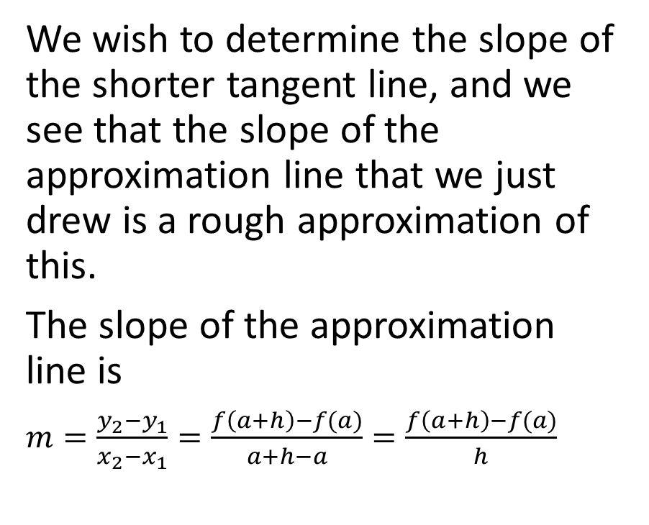

We wish to determine the slope of the shorter tangent line, and we see that the slope of the approximation line that we just drew is a rough approximation of this.
The slope of the approximation line is
$m=\frac{y_{2}−y_{1}}{x_{2}−x_{1}}=\frac{f\left(a+h\right)−f(a)}{a+h−a}=\frac{f\left(a+h\right)−f(a)}{h}$
($a+h,f(a+h)$)
$y=f(x)$
$$(a,f\left(a\right))$$
Horizontal distance is h

Slide 14
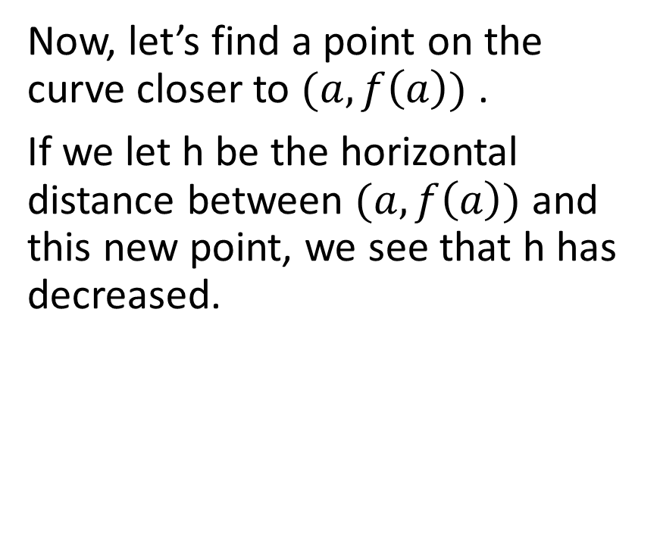

Now, let’s find a point on the curve closer to $(a,f\left(a\right))$ .
If we let h be the horizontal distance between $(a,f\left(a\right))$ and this new point, we see that h has decreased.
($a+h,f(a+h)$)
$y=f(x)$
$$(a,f\left(a\right))$$
Horizontal distance is h

Slide 15
Now, let’s find a point on the curve closer to $(a,f\left(a\right))$ .
If we let h be the horizontal distance between $(a,f\left(a\right))$ and this new point, we see that h has decreased.
($a+h,f(a+h)$)
$y=f(x)$
$$(a,f\left(a\right))$$
Horizontal distance is h

Slide 16

Now, let’s find a point on the curve closer to $(a,f\left(a\right))$ .
If we let h be the horizontal distance between $(a,f\left(a\right))$ and this new point, we see that h has decreased.
($a+h,f(a+h)$)
$y=f(x)$
$$(a,f\left(a\right))$$
Horizontal distance is h

Slide 17
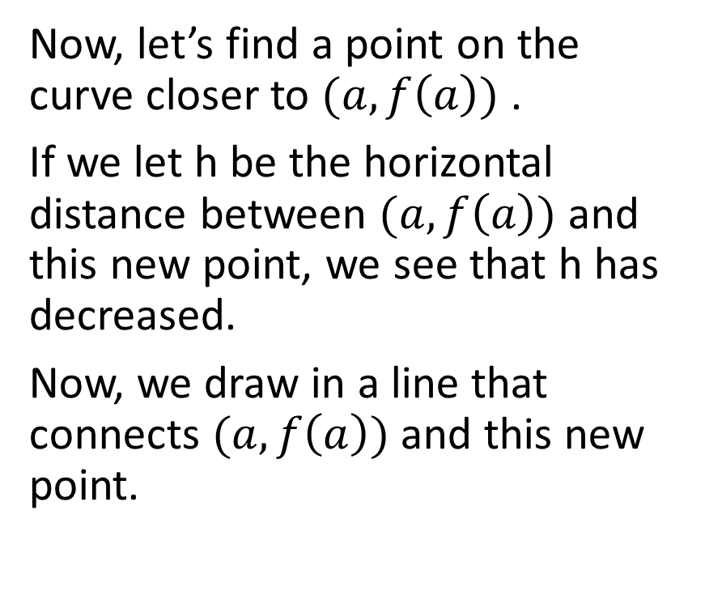

Now, let’s find a point on the curve closer to $(a,f\left(a\right))$ .
If we let h be the horizontal distance between $(a,f\left(a\right))$ and this new point, we see that h has decreased.
Now, we draw in a line that connects $(a,f\left(a\right))$ and this new point.
($a+h,f(a+h)$)
$y=f(x)$
$$(a,f\left(a\right))$$
Horizontal distance is h

Slide 18
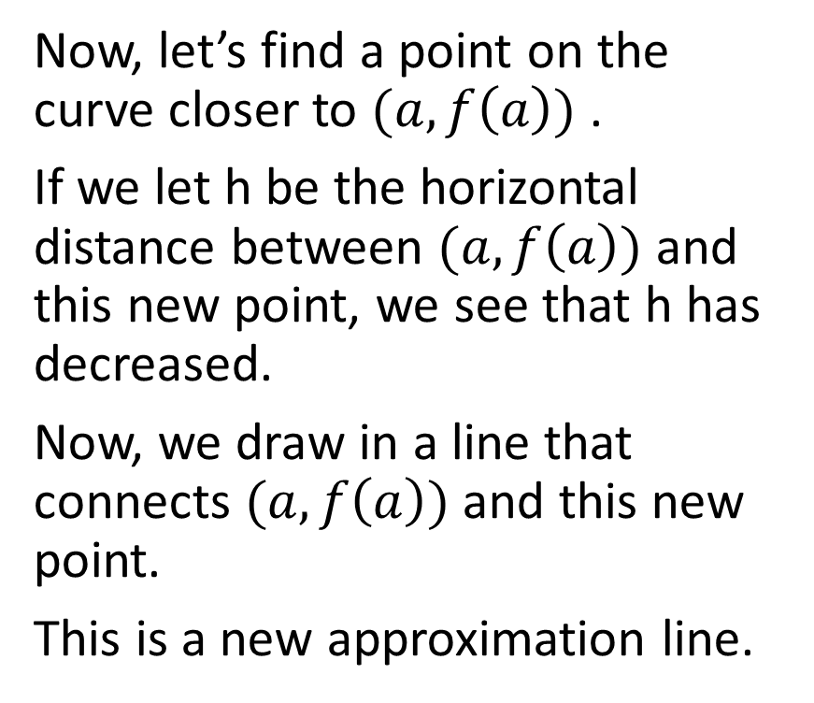

Now, let’s find a point on the curve closer to $(a,f\left(a\right))$ .
If we let h be the horizontal distance between $(a,f\left(a\right))$ and this new point, we see that h has decreased.
Now, we draw in a line that connects $(a,f\left(a\right))$ and this new point.
This is a new approximation line.
($a+h,f(a+h)$)
$y=f(x)$
$$(a,f\left(a\right))$$
Horizontal distance is h

Slide 19
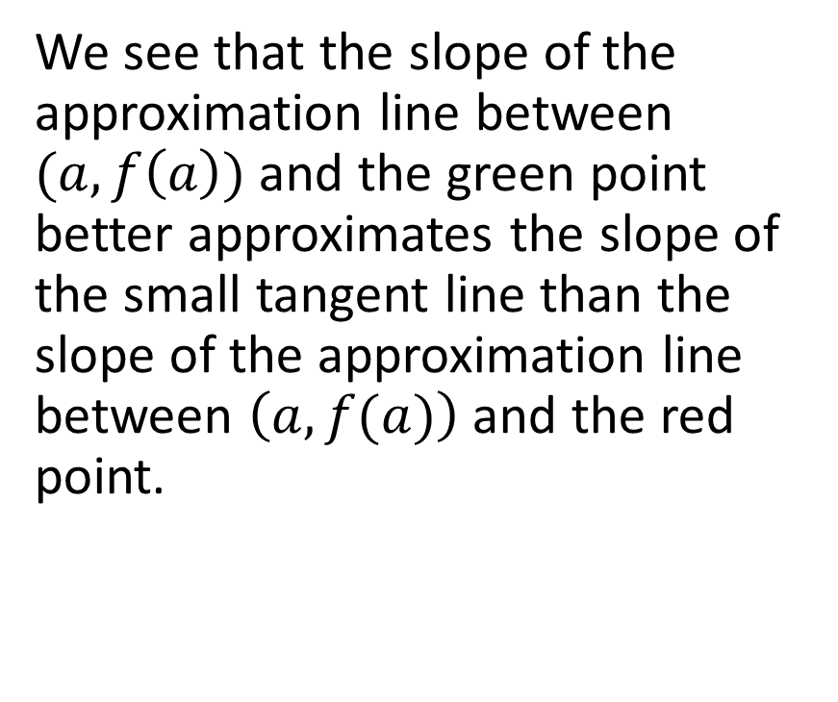

We see that the slope of the approximation line between $(a,f\left(a\right))$ and the green point better approximates the slope of the small tangent line than the slope of the approximation line between $\left(a,f(a)\right)$ and the red point.
($a+h,f(a+h)$)
$y=f(x)$
$$(a,f\left(a\right))$$
Horizontal distance is h

Slide 20
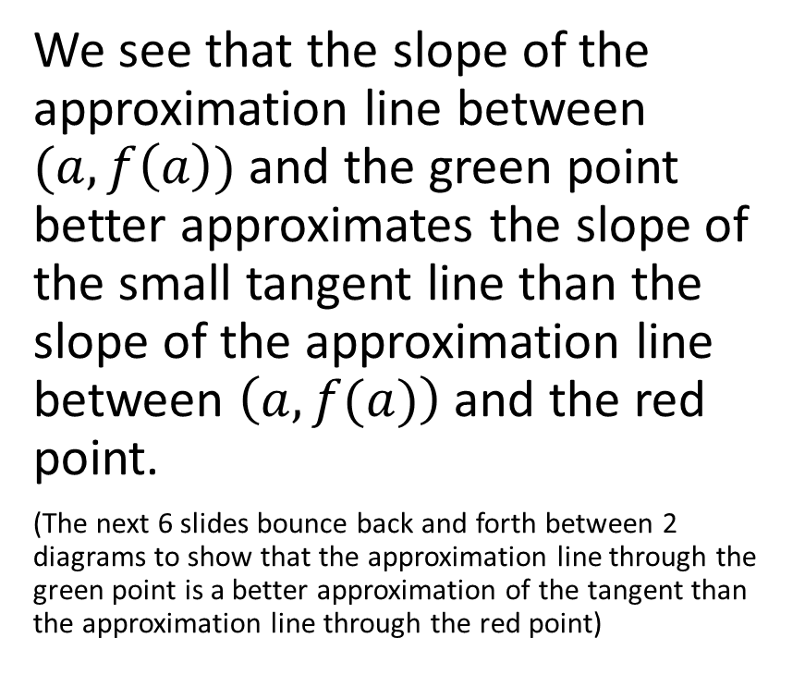
We see that the slope of the approximation line between $(a,f\left(a\right))$ and the green point better approximates the slope of the small tangent line than the slope of the approximation line between $\left(a,f(a)\right)$ and the red point.
(The next 6 slides bounce back and forth between 2 diagrams to show that the approximation line through the green point is a better approximation of the tangent than the approximation line through the red point)
($a+h,f(a+h)$)
$y=f(x)$
$$(a,f\left(a\right))$$
Horizontal distance is h

Slide 21

($a+h,f(a+h)$)
$y=f(x)$
$$(a,f\left(a\right))$$
Horizontal distance is h

Slide 22

($a+h,f(a+h)$)
$y=f(x)$
$$(a,f\left(a\right))$$
Horizontal distance is h

Slide 23

($a+h,f(a+h)$)
$y=f(x)$
$$(a,f\left(a\right))$$
Horizontal distance is h

Slide 24

($a+h,f(a+h)$)
$y=f(x)$
$$(a,f\left(a\right))$$
Horizontal distance is h

Slide 25
($a+h,f(a+h)$)
$y=f(x)$
$$(a,f\left(a\right))$$
Horizontal distance is h

Slide 26

($a+h,f(a+h)$)
$y=f(x)$
$$(a,f\left(a\right))$$
Horizontal distance is h

Slide 27
As we decrease the horizontal distance between the two points, we decrease the overall distance between the two points. Eventually, as h (the horizontal distance between the two points) gets smaller, the points get closer together, and the slope of the approximation line better approximates the slope of the tangent line.
($a+h,f(a+h)$)
$y=f(x)$
$$(a,f\left(a\right))$$
Horizontal distance is h

Slide 28
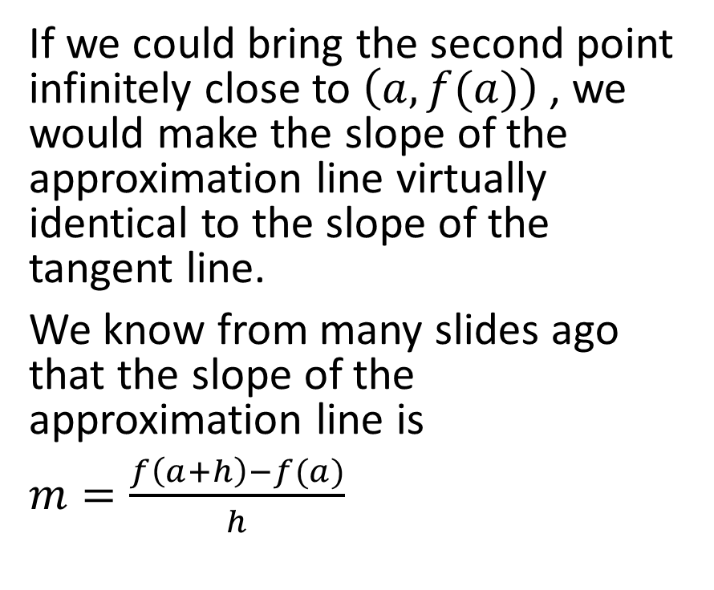
If we could bring the second point infinitely close to $\left(a,f(a)\right)$ , we would make the slope of the approximation line virtually identical to the slope of the tangent line.
We know from many slides ago that the slope of the approximation line is
$m=\frac{f\left(a+h\right)−f(a)}{h}$
($a+h,f(a+h)$)
$y=f(x)$
$$(a,f\left(a\right))$$
Horizontal distance is h

Slide 29
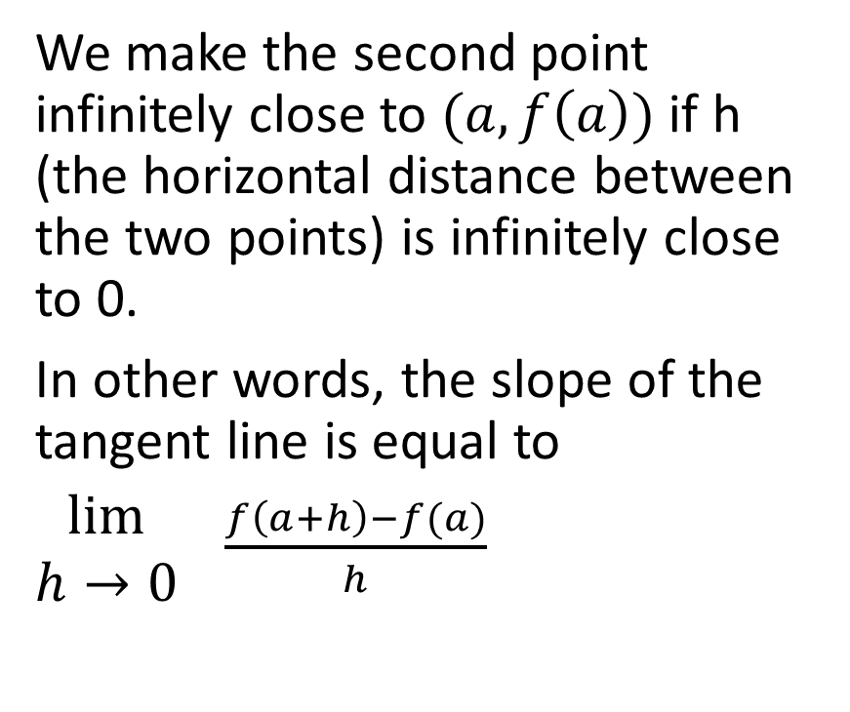
We make the second point infinitely close to $(a,f\left(a\right))$ if h (the horizontal distance between the two points) is infinitely close to 0.
In other words, the slope of the tangent line is equal to
$\begin{matrix}lim⁡ \\ h→0\end{matrix} \frac{f\left(a+h\right)−f(a)}{h}$
($a+h,f(a+h)$)
$y=f(x)$
$$(a,f\left(a\right))$$
Horizontal distance is h

Slide 30
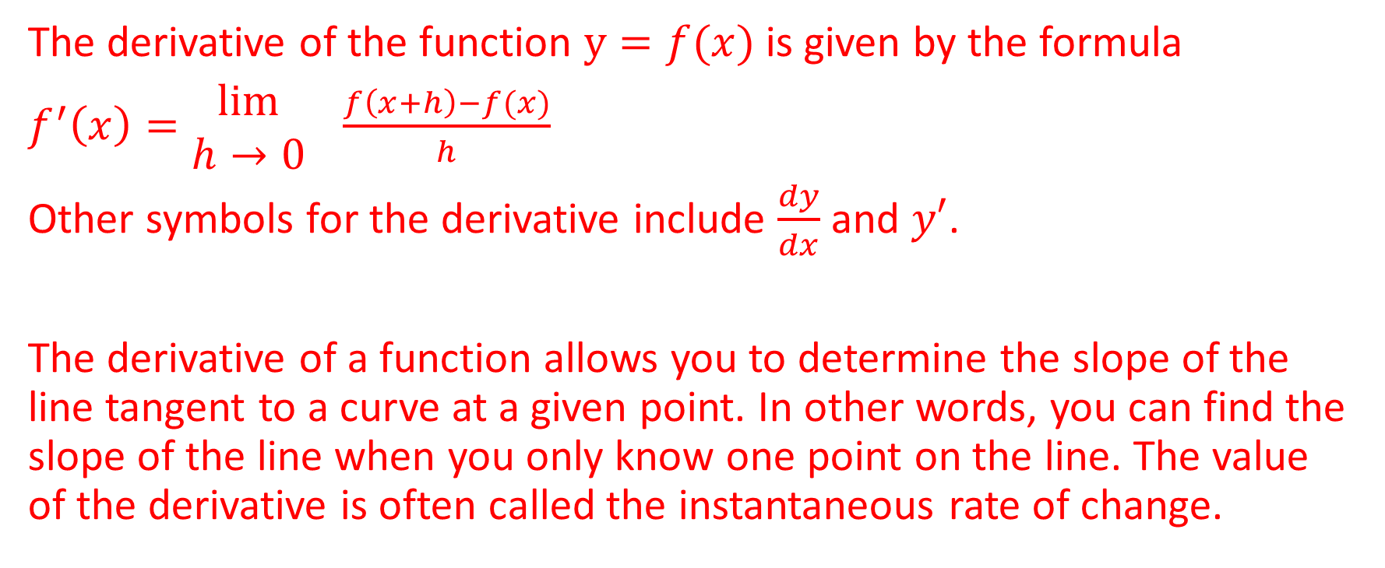
The Derivative
The derivative of the function $y=f(x)$ is given by the formula
$f^{′}\left(x\right)=\begin{matrix}lim⁡ \\ h→0\end{matrix} \frac{f\left(x+h\right)−f(x)}{h}$
Other symbols for the derivative include $\frac{dy}{dx}$ and $y′$.
The derivative of a function allows you to determine the slope of the line tangent to a curve at a given point. In other words, you can find the slope of the line when you only know one point on the line. The value of the derivative is often called the instantaneous rate of change.

Slide 31

Example
Determine the derivative of the function $f\left(x\right)=x^{2}$ and evaluate the derivative of $x=−3$.

Slide 32

Determine the derivative of the function $f\left(x\right)=x^{2}$ and evaluate the derivative of $x=−3$.
Solution:
$f^{′}\left(x\right)=\begin{matrix}lim⁡ \\ h→0\end{matrix} \frac{f\left(x+h\right)−f(x)}{h}$

Slide 33
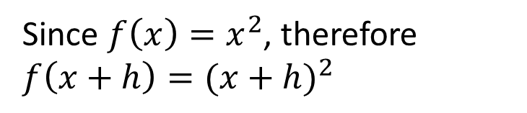
Determine the derivative of the function $f\left(x\right)=x^{2}$ and evaluate the derivative of $x=−3$.
Solution:
$f^{′}\left(x\right)=\begin{matrix}lim⁡ \\ h→0\end{matrix} \frac{f\left(x+h\right)−f(x)}{h}$
Since $f\left(x\right)=x^{2}$, therefore $f\left(x+h\right)={(x+h)}^{2}$

Slide 34

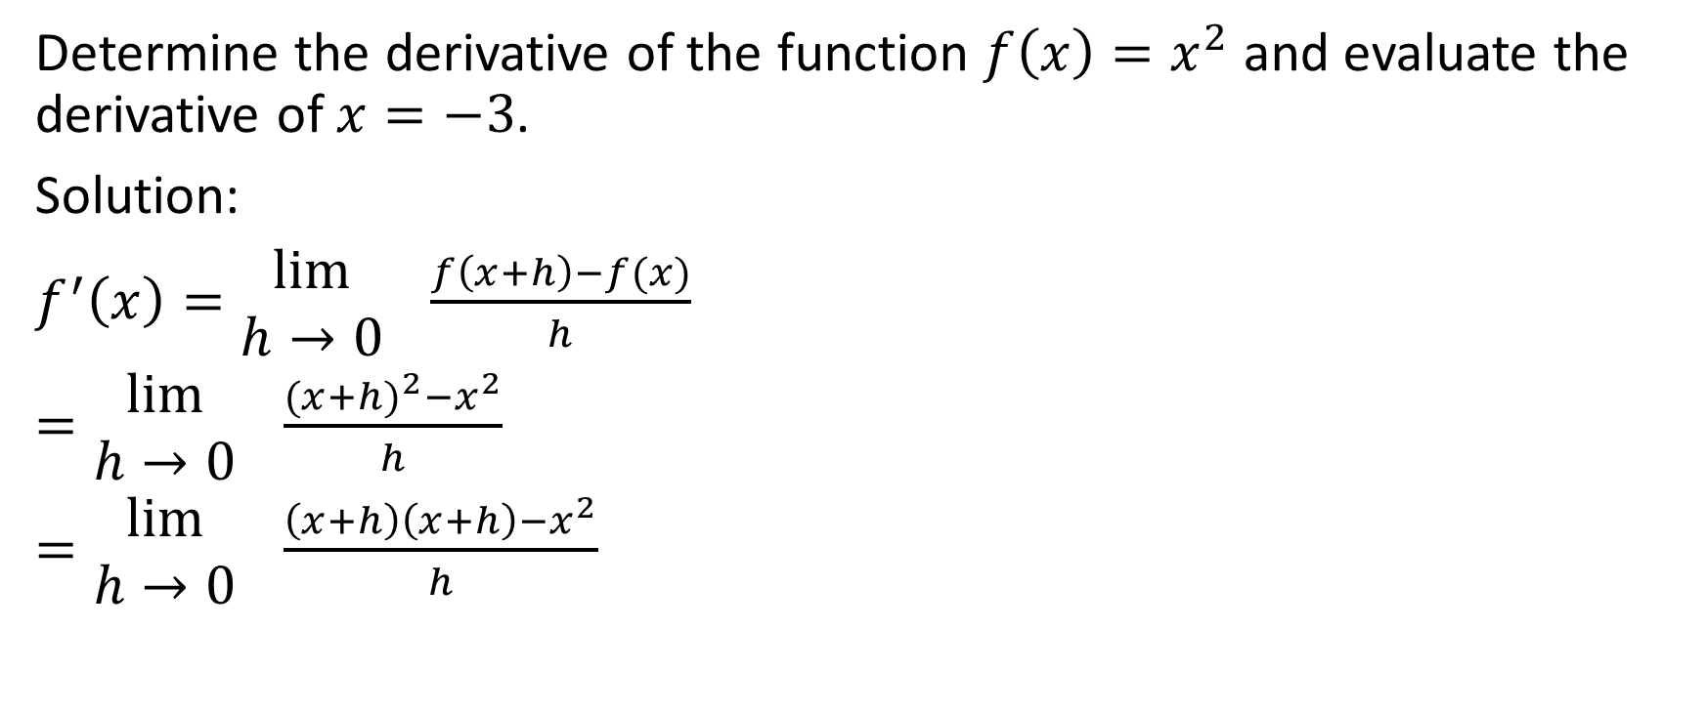
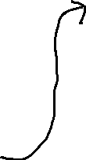
Determine the derivative of the function $f\left(x\right)=x^{2}$ and evaluate the derivative of $x=−3$.
Solution:
$f^{′}\left(x\right)=\begin{matrix}lim⁡ \\ h→0\end{matrix} \frac{f\left(x+h\right)−f(x)}{h}$
$=\begin{matrix}lim⁡ \\ h→0\end{matrix} \frac{{(x+h)}^{2}−x^{2}}{h}$
$=\begin{matrix}lim⁡ \\ h→0\end{matrix} \frac{\left(x+h\right)\left(x+h\right)−x^{2}}{h}$
$=\begin{matrix}lim⁡ \\ h→0\end{matrix} \frac{x^{2}+hx+hx+h^{2}−x^{2}}{h}$
$=\begin{matrix}lim⁡ \\ h→0\end{matrix} \frac{2hx+h^{2}}{h}$
$=\begin{matrix}lim⁡ \\ h→0\end{matrix} \frac{h(2x+h)}{h}$
Now we can cross out the like factors in the numerator and denominator.

Slide 35
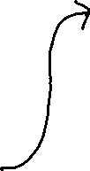
Determine the derivative of the function $f\left(x\right)=x^{2}$ and evaluate the derivative of $x=−3$.
Solution:
$f^{′}\left(x\right)=\begin{matrix}lim⁡ \\ h→0\end{matrix} \frac{f\left(x+h\right)−f(x)}{h}$
$=\begin{matrix}lim⁡ \\ h→0\end{matrix} \frac{{(x+h)}^{2}−x^{2}}{h}$
$=\begin{matrix}lim⁡ \\ h→0\end{matrix} \frac{\left(x+h\right)\left(x+h\right)−x^{2}}{h}$
$=\begin{matrix}lim⁡ \\ h→0\end{matrix} \frac{x^{2}+hx+hx+h^{2}−x^{2}}{h}$
$=\begin{matrix}lim⁡ \\ h→0\end{matrix} \frac{2hx+h^{2}}{h}$
$=\begin{matrix}lim⁡ \\ h→0\end{matrix} \frac{h(2x+h)}{h}$

Slide 36
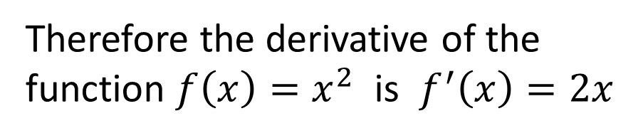

Determine the derivative of the function $f\left(x\right)=x^{2}$ and evaluate the derivative of $x=−3$.
Solution:
$f^{′}\left(x\right)=\begin{matrix}\lim{} \\ h→0\end{matrix} (2x+h)$
$=2x+0$
$=2x$
Therefore the derivative of the function $f\left(x\right)=x^{2}$ is $f^{′}\left(x\right)=2x$

Slide 37
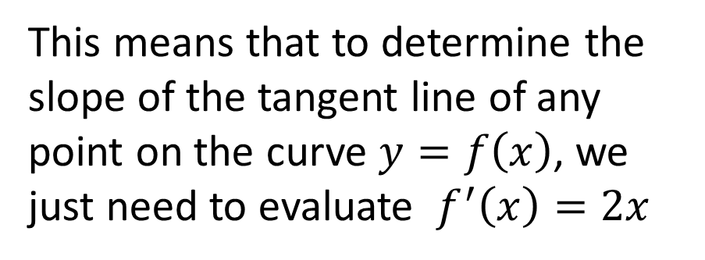
Determine the derivative of the function $f\left(x\right)=x^{2}$ and evaluate the derivative of $x=−3$.
Solution:
$f^{′}\left(x\right)=\begin{matrix}\lim{} \\ h→0\end{matrix} (2x+h)$
$=2x+0$
$=2x$
This means that to determine the slope of the tangent line of any point on the curve $y=f\left(x\right)$, we just need to evaluate $f^{′}\left(x\right)=2x$

Slide 38

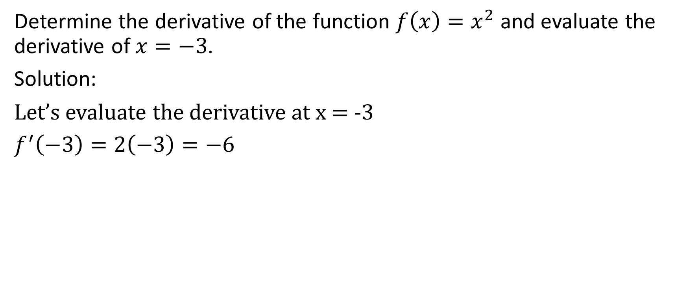
Determine the derivative of the function $f\left(x\right)=x^{2}$ and evaluate the derivative of $x=−3$.
Solution:
Let’s evaluate the derivative at x = -3
$f^{′}\left(−3\right)=2\left(−3\right)=−6$
Therefore at $x=−3$, the derivative is equal to -6

Slide 39

Determine the derivative of the function $f\left(x\right)=x^{2}$ and evaluate the derivative of $x=−3$.
Solution:
Let’s evaluate the derivative at x = -3
$f^{′}\left(−3\right)=2\left(−3\right)=−6$
Therefore at $x=−3$, the slope of the tangent line is -6

Slide 40

Example
Determine the equation of the tangent line to the curve $y=x^{2}$ at the point where $x=−3$

Slide 41
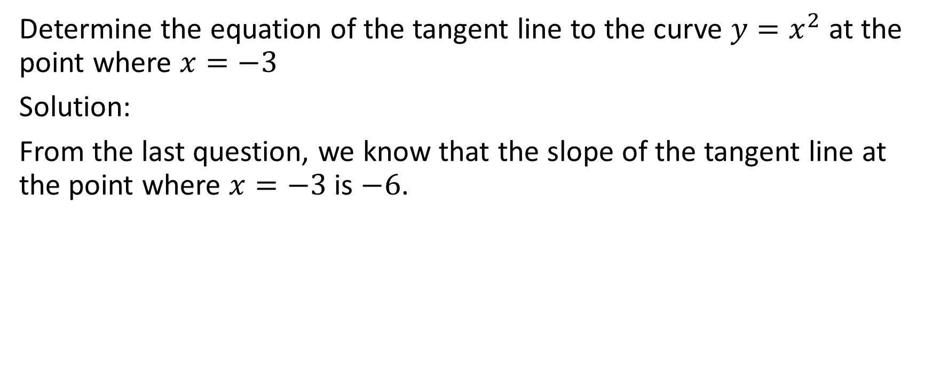
Determine the equation of the tangent line to the curve $y=x^{2}$ at the point where $x=−3$
Solution:
From the last question, we know that the slope of the tangent line at the point where $x=−3$ is $−6$.

Slide 42
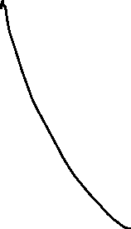

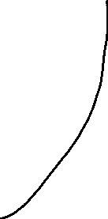
Determine the equation of the tangent line to the curve $y=x^{2}$ at the point where $x=−3$
Solution:
The slope of this tangent line is -6

Slide 43
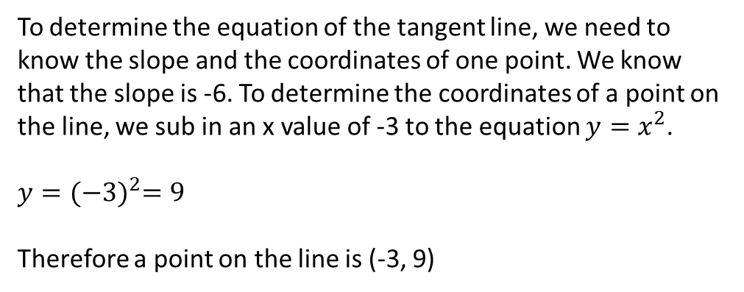
Determine the equation of the tangent line to the curve $y=x^{2}$ at the point where $x=−3$
Solution:
To determine the equation of the tangent line, we need to know the slope and the coordinates of one point. We know that the slope is -6. To determine the coordinates of a point on the line, we sub in an x value of -3 to the equation $y=x^{2}$.
$y={(−3)}^{2}=9$
Therefore a point on the line is (-3, 9)
The slope of this tangent line is -6

Slide 44

Determine the equation of the tangent line to the curve $y=x^{2}$ at the point where $x=−3$
Solution:
$y=−6x+b$
Sub in $(−3,9)$
$9=−6\left(−3\right)+b$
$9=18+b$
$9−18=b$
$−9=b$
Therefore the equation of the tangent line is $y=−6x−9$
The slope of this tangent line is -6

Slide 45

Example
Determine the derivative $f′(t)$ of the function $f\left(t\right)=\sqrt{t}, t>0$

Slide 46
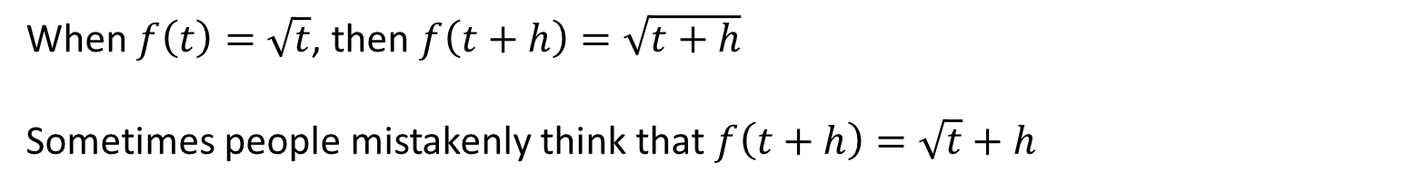

Determine the derivative $f′(t)$ of the function $f\left(t\right)=\sqrt{t}, t>0$
Solution:
$f^{′}\left(t\right)=\begin{matrix}lim⁡ \\ h→0\end{matrix} \frac{f\left(t+h\right)−f(t)}{h}$
When $f\left(t\right)=\sqrt{t}$, then $f\left(t+h\right)=\sqrt{t+h}$
Sometimes people mistakenly think that $f\left(t+h\right)=\sqrt{t}+h$

Slide 47
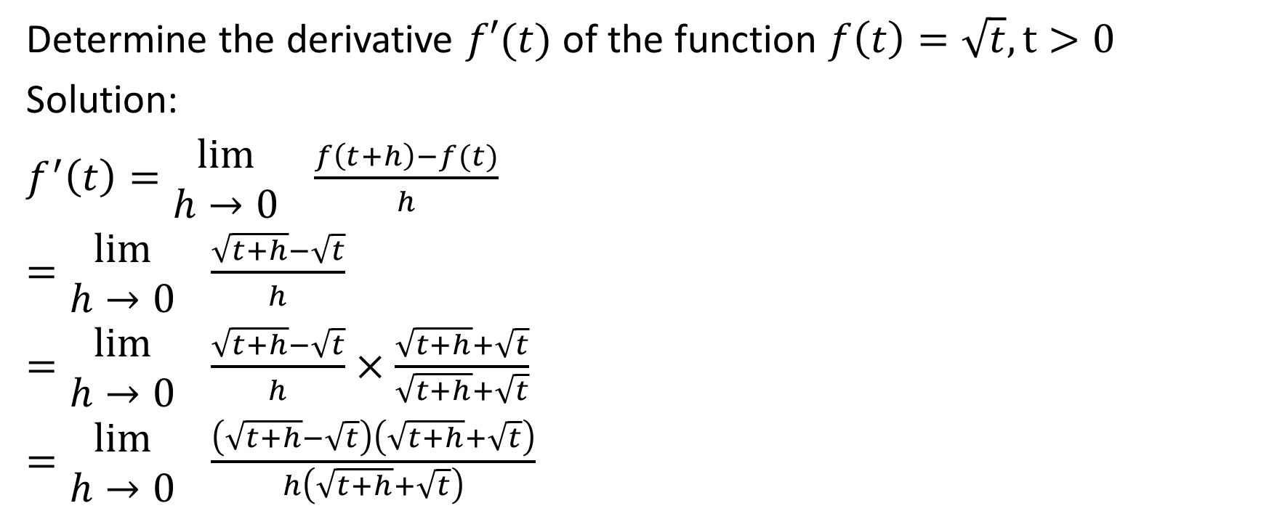
Determine the derivative $f′(t)$ of the function $f\left(t\right)=\sqrt{t}, t>0$
Solution:
$f^{′}\left(t\right)=\begin{matrix}lim⁡ \\ h→0\end{matrix} \frac{f\left(t+h\right)−f(t)}{h}$
$=\begin{matrix}lim⁡ \\ h→0\end{matrix} \frac{\sqrt{t+h}−\sqrt{t}}{h}$
$=\begin{matrix}lim⁡ \\ h→0\end{matrix} \frac{\sqrt{t+h}−\sqrt{t}}{h}×\frac{\sqrt{t+h}+\sqrt{t}}{\sqrt{t+h}+\sqrt{t}}$
$=\begin{matrix}lim⁡ \\ h→0\end{matrix} \frac{\left(\sqrt{t+h}−\sqrt{t}\right)\left(\sqrt{t+h}+\sqrt{t}\right)}{h\left(\sqrt{t+h}+\sqrt{t}\right)}$

Slide 48
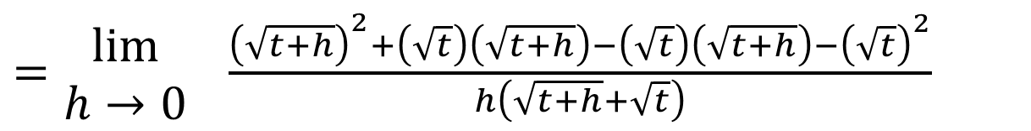

Determine the derivative $f′(t)$ of the function $f\left(t\right)=\sqrt{t}, t>0$
Solution:
$=\begin{matrix}lim⁡ \\ h→0\end{matrix} \frac{{\left(\sqrt{t+h}\right)}^{2}+\left(\sqrt{t}\right)\left(\sqrt{t+h}\right)−\left(\sqrt{t}\right)\left(\sqrt{t+h}\right)−{\left(\sqrt{t}\right)}^{2}}{h\left(\sqrt{t+h}+\sqrt{t}\right)}$

Slide 49



Determine the derivative $f′(t)$ of the function $f\left(t\right)=\sqrt{t}, t>0$
Solution:
$=\begin{matrix}lim⁡ \\ h→0\end{matrix} \frac{{\left(\sqrt{t+h}\right)}^{2}+\left(\sqrt{t}\right)\left(\sqrt{t+h}\right)−\left(\sqrt{t}\right)\left(\sqrt{t+h}\right)−{\left(\sqrt{t}\right)}^{2}}{h\left(\sqrt{t+h}+\sqrt{t}\right)}$
${\left(\sqrt{t+h}\right)}^{2}=t+h$

Slide 50


Determine the derivative $f′(t)$ of the function $f\left(t\right)=\sqrt{t}, t>0$
Solution:
$=\begin{matrix}lim⁡ \\ h→0\end{matrix} \frac{{\left(\sqrt{t+h}\right)}^{2}+\left(\sqrt{t}\right)\left(\sqrt{t+h}\right)−\left(\sqrt{t}\right)\left(\sqrt{t+h}\right)−{\left(\sqrt{t}\right)}^{2}}{h\left(\sqrt{t+h}+\sqrt{t}\right)}$
The middle terms will cancel out.

Slide 51
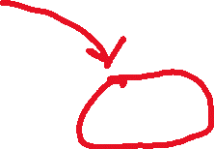


Determine the derivative $f′(t)$ of the function $f\left(t\right)=\sqrt{t}, t>0$
Solution:
$=\begin{matrix}lim⁡ \\ h→0\end{matrix} \frac{{\left(\sqrt{t+h}\right)}^{2}+\left(\sqrt{t}\right)\left(\sqrt{t+h}\right)−\left(\sqrt{t}\right)\left(\sqrt{t+h}\right)−{\left(\sqrt{t}\right)}^{2}}{h\left(\sqrt{t+h}+\sqrt{t}\right)}$
${\left(\sqrt{t}\right)}^{2}=t$

Slide 52

Determine the derivative $f′(t)$ of the function $f\left(t\right)=\sqrt{t}, t>0$
Solution:
$=\begin{matrix}lim⁡ \\ h→0\end{matrix} \frac{{\left(\sqrt{t+h}\right)}^{2}+\left(\sqrt{t}\right)\left(\sqrt{t+h}\right)−\left(\sqrt{t}\right)\left(\sqrt{t+h}\right)−{\left(\sqrt{t}\right)}^{2}}{h\left(\sqrt{t+h}+\sqrt{t}\right)}$
$=\begin{matrix}lim⁡ \\ h→0\end{matrix}$ $\frac{\left(t+h\right)−t}{h\left(\sqrt{t+h}+\sqrt{t}\right)}$
$=\begin{matrix}lim⁡ \\ h→0\end{matrix} \frac{t+h−t}{h\left(\sqrt{t+h}+\sqrt{t}\right)}$
$=\begin{matrix}lim⁡ \\ h→0\end{matrix} \frac{h}{h\left(\sqrt{t+h}+\sqrt{t}\right)}$
We can cross out like factors in the numerator and denominator.

Slide 53

Determine the derivative $f′(t)$ of the function $f\left(t\right)=\sqrt{t}, t>0$
Solution:
$=\begin{matrix}lim⁡ \\ h→0\end{matrix} \frac{1}{\left(\sqrt{t+h}+\sqrt{t}\right)}$
$=\frac{1}{\sqrt{t+0}+\sqrt{t}}$
$=\frac{1}{\sqrt{t}+\sqrt{t}}$
$=\frac{1}{2\sqrt{t}}$

Slide 54

Example
Given that $y={3x}^{2}−7x+6$, determine the value of $\frac{dy}{dx}$ at $x=5$.

Slide 55
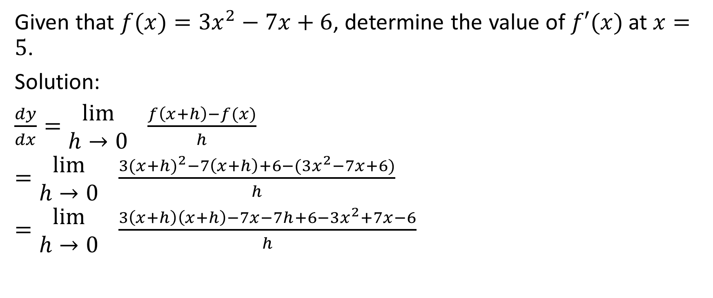
Given that $f(x)={3x}^{2}−7x+6$, determine the value of $f′(x)$ at $x=5$.
Solution:
$\frac{dy}{dx}=\begin{matrix}lim⁡ \\ h→0\end{matrix} \frac{f\left(x+h\right)−f(x)}{h}$
$=\begin{matrix}lim⁡ \\ h→0\end{matrix} \frac{3{(x+h)}^{2}−7\left(x+h\right)+6−(3x^{2}−7x+6)}{h}$
$=\begin{matrix}lim⁡ \\ h→0\end{matrix} \frac{3\left(x+h\right)\left(x+h\right)−7x−7h+6−3x^{2}+7x−6}{h}$

Slide 56
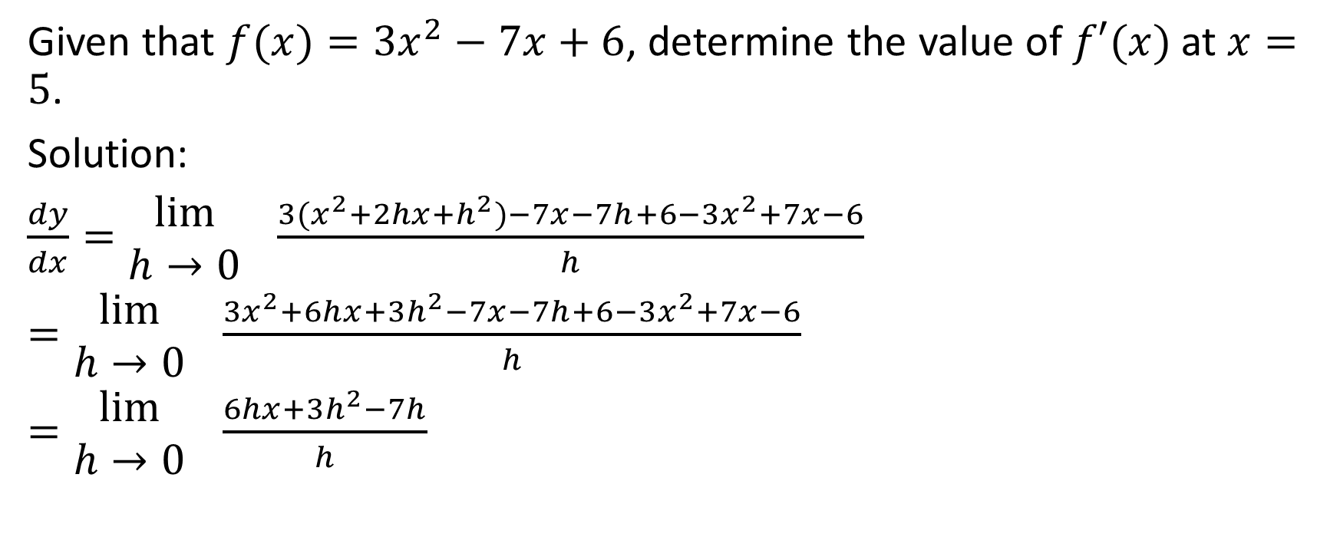
Given that $f(x)={3x}^{2}−7x+6$, determine the value of $f′(x)$ at $x=5$.
Solution:
$\frac{dy}{dx}=\begin{matrix}lim⁡ \\ h→0\end{matrix} \frac{3(x^{2}+2hx+h^{2})−7x−7h+6−3x^{2}+7x−6}{h}$
$=\begin{matrix}lim⁡ \\ h→0\end{matrix} \frac{3x^{2}+6hx+3h^{2}−7x−7h+6−3x^{2}+7x−6}{h}$
$=\begin{matrix}lim⁡ \\ h→0\end{matrix} \frac{6hx+3h^{2}−7h}{h}$

Slide 57

Given that $f(x)={3x}^{2}−7x+6$, determine the value of $f′(x)$ at $x=5$.
Solution:
$\frac{dy}{dx}=\begin{matrix}lim⁡ \\ h→0\end{matrix} \frac{h(6x+3h−7)}{h}$
$=\begin{matrix}lim⁡ \\ h→0\end{matrix} (6x+3h−7)$
$=6x+3\left(0\right)−7$
$=6x−7$

Slide 58

Given that $f(x)={3x}^{2}−7x+6$, determine the value of $f′(x)$ at $x=5$.
Solution:
Therefore, $\frac{dy}{dx}=6x−7$
At $x=5, \frac{dy}{dx}=6\left(5\right)−7=30−7=23$

Slide 59

Example
Given that $f(x)=\sqrt{3x+4}$, determine $f′(7)$

Slide 60

Given that $f(x)=\sqrt{3x+4}$, determine $f′(7)$
Solution:
$f′(x)=\begin{matrix}lim⁡ \\ h→0\end{matrix} \frac{f\left(x+h\right)−f(x)}{h}$
$=\begin{matrix}lim⁡ \\ h→0\end{matrix} \frac{\sqrt{3\left(x+h\right)+4} − \sqrt{3x+4}}{h}$
$=\begin{matrix}lim⁡ \\ h→0\end{matrix} \frac{\sqrt{3x+3h+4} − \sqrt{3x+4}}{h}$
$=\begin{matrix}lim⁡ \\ h→0\end{matrix} \frac{\sqrt{3x+3h+4} − \sqrt{3x+4}}{h} × \frac{\sqrt{3x+3h+4} + \sqrt{3x+4}}{\sqrt{3x+3h+4} + \sqrt{3x+4}}$

Slide 61

Given that $f(x)=\sqrt{3x+4}$, determine $f′(7)$
Solution:
$f′(x)=\begin{matrix}lim⁡ \\ h→0\end{matrix} \frac{\left( \sqrt{3x+3h+4} − \sqrt{3x+4} \right)(\sqrt{3x+3h+4} + \sqrt{3x+4} )}{h (\sqrt{3x+3h+4} + \sqrt{3x+4})}$
$=\begin{matrix}lim⁡ \\ h→0\end{matrix} \frac{{\left(\sqrt{3x+3h+4}\right)}^{2}+ \left(\sqrt{3x+3h+4}\right)\left(\sqrt{3x+4}\right)−\left(\sqrt{3x+3h+4}\right)\left(\sqrt{3x+4}\right)−{\left(\sqrt{3x+4}\right)}^{2}}{(h)\left(\sqrt{3x+3h+4} + \sqrt{3x+4}\right)}$

Slide 62



Given that $f(x)=\sqrt{3x+4}$, determine $f′(7)$
Solution:
$f′(x)=\begin{matrix}lim⁡ \\ h→0\end{matrix} \frac{\left( \sqrt{3x+3h+4} − \sqrt{3x+4} \right)(\sqrt{3x+3h+4} + \sqrt{3x+4} )}{h (\sqrt{3x+3h+4} + \sqrt{3x+4})}$
$=\begin{matrix}lim⁡ \\ h→0\end{matrix} \frac{{\left(\sqrt{3x+3h+4}\right)}^{2}+ \left(\sqrt{3x+3h+4}\right)\left(\sqrt{3x+4}\right)−\left(\sqrt{3x+3h+4}\right)\left(\sqrt{3x+4}\right)−{\left(\sqrt{3x+4}\right)}^{2}}{(h)\left(\sqrt{3x+3h+4} + \sqrt{3x+4}\right)}$
$${\left(\sqrt{3x+3h+4}\right)}^{2}=3x+3h+4$$

Slide 63


Given that $f(x)=\sqrt{3x+4}$, determine $f′(7)$
Solution:
$f′(x)=\begin{matrix}lim⁡ \\ h→0\end{matrix} \frac{\left( \sqrt{3x+3h+4} − \sqrt{3x+4} \right)(\sqrt{3x+3h+4} + \sqrt{3x+4} )}{h (\sqrt{3x+3h+4} + \sqrt{3x+4})}$
$=\begin{matrix}lim⁡ \\ h→0\end{matrix} \frac{{\left(\sqrt{3x+3h+4}\right)}^{2}+ \left(\sqrt{3x+3h+4}\right)\left(\sqrt{3x+4}\right)−\left(\sqrt{3x+3h+4}\right)\left(\sqrt{3x+4}\right)−{\left(\sqrt{3x+4}\right)}^{2}}{(h)\left(\sqrt{3x+3h+4} + \sqrt{3x+4}\right)}$
The middle terms cancel out

Slide 64


Given that $f(x)=\sqrt{3x+4}$, determine $f′(7)$
Solution:
$f′(x)=\begin{matrix}lim⁡ \\ h→0\end{matrix} \frac{\left( \sqrt{3x+3h+4} − \sqrt{3x+4} \right)(\sqrt{3x+3h+4} + \sqrt{3x+4} )}{h (\sqrt{3x+3h+4} + \sqrt{3x+4})}$
$=\begin{matrix}lim⁡ \\ h→0\end{matrix} \frac{{\left(\sqrt{3x+3h+4}\right)}^{2}+ \left(\sqrt{3x+3h+4}\right)\left(\sqrt{3x+4}\right)−\left(\sqrt{3x+3h+4}\right)\left(\sqrt{3x+4}\right)−{\left(\sqrt{3x+4}\right)}^{2}}{(h)\left(\sqrt{3x+3h+4} + \sqrt{3x+4}\right)}$
$${\left(\sqrt{3x+4}\right)}^{2}=3x+4$$

Slide 65

Given that $f(x)=\sqrt{3x+4}$, determine $f′(7)$
Solution:
$f′(x)=\begin{matrix}lim⁡ \\ h→0\end{matrix} \frac{\left( \sqrt{3x+3h+4} − \sqrt{3x+4} \right)(\sqrt{3x+3h+4} + \sqrt{3x+4} )}{h (\sqrt{3x+3h+4} + \sqrt{3x+4})}$
$=\begin{matrix}lim⁡ \\ h→0\end{matrix} \frac{{\left(\sqrt{3x+3h+4}\right)}^{2}+ \left(\sqrt{3x+3h+4}\right)\left(\sqrt{3x+4}\right)−\left(\sqrt{3x+3h+4}\right)\left(\sqrt{3x+4}\right)−{\left(\sqrt{3x+4}\right)}^{2}}{(h)\left(\sqrt{3x+3h+4} + \sqrt{3x+4}\right)}$
$=\begin{matrix}lim⁡ \\ h→0\end{matrix} \frac{3x+3h+4 −(3x+4)}{(h)\left(\sqrt{3x+3h+4} + \sqrt{3x+4}\right)}$
$=\begin{matrix}lim⁡ \\ h→0\end{matrix} \frac{3x+3h+4 −3x−4}{(h)\left(\sqrt{3x+3h+4} + \sqrt{3x+4}\right)}$

Slide 66

Given that $f(x)=\sqrt{3x+4}$, determine $f′(7)$
Solution:
$f^{′}\left(x\right)=\begin{matrix}lim⁡ \\ h→0\end{matrix} \frac{3h}{(h)\left(\sqrt{3x+3h+4} + \sqrt{3x+4}\right)}$
$=\begin{matrix}lim⁡ \\ h→0\end{matrix} \frac{3}{\left(\sqrt{3x+3h+4} + \sqrt{3x+4}\right)}$
$= \frac{3}{\left(\sqrt{3x+3(0)+4} + \sqrt{3x+4}\right)}$
$= \frac{3}{\left(\sqrt{3x+4} + \sqrt{3x+4}\right)}$

Slide 67

Given that $f(x)=\sqrt{3x+4}$, determine $f′(7)$
Solution:
$f^{′}\left(x\right)= \frac{3}{2\sqrt{3x+4} }$

Slide 68

Given that $f(x)=\sqrt{3x+4}$, determine $f′(7)$
Solution:
$f^{′}\left(x\right)= \frac{3}{2\sqrt{3x+4} }$
$f^{′}\left(7\right)= \frac{3}{2\sqrt{3(7)+4} }$
$= \frac{3}{2\sqrt{21+4} }$
$= \frac{3}{2\sqrt{25} }=\frac{3}{2(5)}=\frac{3}{10}$

Slide 69

Example
Determine the equation of the tangent line of the curve $f\left(x\right)=\frac{1}{x}$ at the point where $x=2$

Slide 70


Determine the equation of the tangent line of the curve $f\left(x\right)=\frac{1}{x}$ at the point where $x=2$
Solution:
$f^{′}\left(x\right)=\begin{matrix}lim⁡ \\ h→0\end{matrix} \frac{f\left(x+h\right)−f(x)}{h}$
$=\begin{matrix}lim⁡ \\ h→0\end{matrix} \frac{ \frac{1}{x+h} − \frac{1}{x} }{h}$
Looking at the terms in the numerator, we see that there is a common denominator of $x(x+h)$

Slide 71



Determine the equation of the tangent line of the curve $f\left(x\right)=\frac{1}{x}$ at the point where $x=2$
Solution:
$f^{′}\left(x\right)=\begin{matrix}lim⁡ \\ h→0\end{matrix} \frac{f\left(x+h\right)−f(x)}{h}$
$=\begin{matrix}lim⁡ \\ h→0\end{matrix} \frac{ \frac{1}{x+h} − \frac{1}{x} }{h}$
$=\begin{matrix}lim⁡ \\ h→0\end{matrix} \frac{ \frac{x}{x(x+h)} − \frac{x+h}{x(x+h)} }{h}$
$=\begin{matrix}lim⁡ \\ h→0\end{matrix} \frac{ \frac{x −(x+h)}{x(x+h)} }{h}$
$=\begin{matrix}lim⁡ \\ h→0\end{matrix} \frac{ \frac{x − x − h}{x(x+h)} }{h}$
$=\begin{matrix}lim⁡ \\ h→0\end{matrix} \frac{ \frac{−h}{x(x+h)} }{h}$

Slide 72

Determine the equation of the tangent line of the curve $f\left(x\right)=\frac{1}{x}$ at the point where $x=2$
Solution:
$=\begin{matrix}lim⁡ \\ h→0\end{matrix} \frac{ −h}{x\left(x+h\right) } ÷h$
$=\begin{matrix}lim⁡ \\ h→0\end{matrix} \frac{ −h}{x\left(x+h\right) } × \frac{1}{h}$
$=\begin{matrix}lim⁡ \\ h→0\end{matrix} \frac{ −1(h)}{hx\left(x+h\right) }$
Now, we can cross out like factors from the numerator and denominator.

Slide 73


Determine the equation of the tangent line of the curve $f\left(x\right)=\frac{1}{x}$ at the point where $x=2$
Solution:
$=\begin{matrix}lim⁡ \\ h→0\end{matrix} \frac{ −h}{x\left(x+h\right) } ÷h$
$=\begin{matrix}lim⁡ \\ h→0\end{matrix} \frac{ −h}{x\left(x+h\right) } × \frac{1}{h}$
$=\begin{matrix}lim⁡ \\ h→0\end{matrix} \frac{ −1(h)}{hx\left(x+h\right) }$
$=\begin{matrix}lim⁡ \\ h→0\end{matrix} \frac{ −1}{x\left(x+h\right) }$
$= \frac{−1}{x(x+0)}$
$=\frac{−1}{x(x)}$
$=\frac{−1}{x^{2}}$

Slide 74

Determine the equation of the tangent line of the curve $f\left(x\right)=\frac{1}{x}$ at the point where $x=2$
Solution:
We know that $f^{′}\left(x\right)=\frac{−1}{x^{2}}$
This means that $f^{′}\left(2\right)=\frac{−1}{{(2)}^{2}}=\frac{−1}{4}$
Therefore, the slope of the tangent line where x = 2 is $\frac{−1}{4}$

Slide 75

Determine the equation of the tangent line of the curve $f\left(x\right)=\frac{1}{x}$ at the point where $x=2$
Solution:
At $x=2$, $y=\frac{1}{2}$
This means that the tangent line goes through the point $\left(2,\frac{1}{2}\right)$ and has a slope of $\frac{−1}{4}$

Slide 76


Determine the equation of the tangent line of the curve $f\left(x\right)=\frac{1}{x}$ at the point where $x=2$
Solution:
Therefore, $y=\frac{−1}{4}x+b$
$\frac{1}{2}=\frac{−1}{4}\left(2\right)+b$
$\frac{1}{2}=\frac{−1}{2}+b$
$1=b$
Therefore, the equation of the tangent line where x = 2 is
$y=\frac{−1}{4}x+1$

Slide 77

This is what the graph and the tangent line would look like.

Slide 78

Example
Determine an equation of the line that is perpendicular to the tangent to the graph of $f\left(x\right)=\frac{1}{x}$ at the point where $x=2$ and that intersects it at the point of tangency. (this is called the normal)

Slide 79

Determine an equation of the line that is perpendicular to the tangent to the graph of $f\left(x\right)=\frac{1}{x}$ at the point where $x=2$ and that intersects it at the point of tangency. (this is called the normal)
Solution:
We know from the last question that at the point where $x=2$, $y=\frac{1}{2}.$ In other words, the point of tangency is $\left(2,\frac{1}{2}\right)$
We also know that the slope of the tangent line is $\frac{−1}{4}$, so the slope of the normal would be the negative reciprocal, which is 4.

Slide 80





Determine an equation of the line that is perpendicular to the tangent to the graph of $f\left(x\right)=\frac{1}{x}$ at the point where $x=2$ and that intersects it at the point of tangency. (this is called the normal)
Solution:
Therefore, the equation of the line is $y=4x+b$ and it extends through the point $\left(2,\frac{1}{2}\right)$.
$\frac{1}{2}=4\left(2\right)+b$
$\frac{1}{2}=8+b$
Therefore the equation of the normal is $y=4x − \frac{15}{2}$
$\frac{−15}{2}=b$

Slide 81

The normal is shown here (highlighted in yellow).

Slide 82








The Existence of Derivatives
A function $f$ is said to be differentiable at $x=a$ if $f′(a)$ exists. At points where $f$ is not differentiable, we say that the derivative does not exist. Common ways for a derivative to not exist are shown.
Discontinuity (hole, or jump discontinuity as happens in a piecewise function)
Cusp
Vertical Tangent
Corner as in $y=\left|x\right|$

Slide 83

A function $f$ is said to be differentiable at $x=a$ if $f′(a)$ exists. At points where $f$ is not differentiable, we say that the derivative does not exist. Common ways for a derivative to not exist are shown.
In our graphing unit, we will see an algebraic reason for there not being a valid derivative value at the point of the cusp, but for now we can focus on the fact that there would not be only one possible tangent line.
Cusp

Slide 84
A function $f$ is said to be differentiable at $x=a$ if $f′(a)$ exists. At points where $f$ is not differentiable, we say that the derivative does not exist. Common ways for a derivative to not exist are shown.
In our graphing unit, we will see an algebraic reason for there not being a valid derivative value at the point of the cusp, but for now we can focus on the fact that there would not be only one possible tangent line.
Cusp

Slide 85
A function $f$ is said to be differentiable at $x=a$ if $f′(a)$ exists. At points where $f$ is not differentiable, we say that the derivative does not exist. Common ways for a derivative to not exist are shown.
In our graphing unit, we will see an algebraic reason for there not being a valid derivative value at the point of the cusp, but for now we can focus on the fact that there would not be only one possible tangent line.
Cusp

Slide 86
A function $f$ is said to be differentiable at $x=a$ if $f′(a)$ exists. At points where $f$ is not differentiable, we say that the derivative does not exist. Common ways for a derivative to not exist are shown.
In our graphing unit, we will see an algebraic reason for there not being a valid derivative value at the point of the cusp, but for now we can focus on the fact that there would not be only one possible tangent line.
Cusp

Slide 87
A function $f$ is said to be differentiable at $x=a$ if $f′(a)$ exists. At points where $f$ is not differentiable, we say that the derivative does not exist. Common ways for a derivative to not exist are shown.
The rationale for the non-existence of a derivative in this case is the same as in the case of a cusp.
Corner as in $y=\left|x\right|$

Slide 88
A function $f$ is said to be differentiable at $x=a$ if $f′(a)$ exists. At points where $f$ is not differentiable, we say that the derivative does not exist. Common ways for a derivative to not exist are shown.
In this case, the only tangent line that can be drawn is vertical. However, a vertical tangent has an undefined slope. Since the value of the derivative at a given point is the value of the slope, therefore the value of the derivative is undefined. We say that the derivative does not exist.
Vertical Tangent

Slide 89
A function $f$ is said to be differentiable at $x=a$ if $f′(a)$ exists. At points where $f$ is not differentiable, we say that the derivative does not exist. Common ways for a derivative to not exist are shown.
The derivative cannot have a value at a point that does not exist
Discontinuity (hole, or jump discontinuity as happens in a piecewise function)

